Slide 1
Counting in KS1

Slide 2
Counting in Key Stage 1
Year 1
Count forwards and backwards to 100 and beyond (from different starting points)
Count in steps of 2 up to 20 (e.g. 2, 4, 6, 8, etc)
Count in steps of 5 up to 50 (e.g. 5, 10, 15, 20, etc)
Count in steps of 10 up to 100 (e.g. 10, 20, 30, 40, etc)
Year 2
Count in steps of 10 from any number
Count in steps of 3
2, 5 and 10 times tables and division facts

Slide 3
Counting Challenges
Year 1
Count out 1 more and 1 less than a given number up to 100.
Count out 2 more and 2 less than a given number.
Use ordinal numbers to 10th and then to 20th (e.g. 1st, 2nd, 3rd etc).
Year 2
Count in 2’s from an odd number.
Count up to 100 objects by grouping them into 10’s, 5’s or 2’s
Investigate patterns in a 100 square.

Slide 4
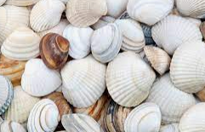

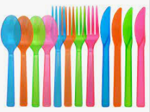
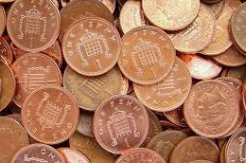
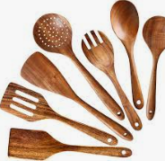

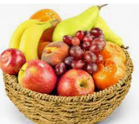



Counting at Home

Slide 5
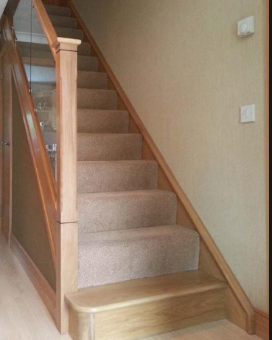

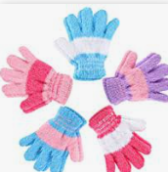
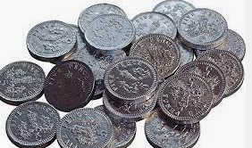
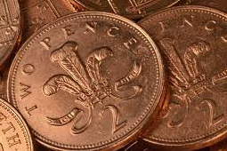


Step counting

Slide 6




In the garden
- Number formation
- Make a number line

Slide 7
Mastering Number
Subitising
Subitising is when you are able to look at a group of objects and realise how many there are without counting. This only works with small groups of numbers, as we can only subitise up to 5 things

Slide 8


Slide 9
Notes:
Did you need to count? Of course not - we can all see that was 2!

Slide 10
Notes:
Did you need to count?

Slide 12

Notes:
What helps you to see four here?
Tell your grown-up where you have seen this four before.

Slide 14
Mastering Number 2021/22 ncetm.org.uk

Slide 16
Number Facts
Year 1
Adding within 10 and then 20
Subtracting within 10 and then 20
Doubles
Halves
1 more and 1 less
10 more and 10 less
Year 2
Times tables! (2’s, 5’s and 10’s)

Slide 17
Year 1 (Numbots website)
subitising
number facts within 10 /20
doubling / halving
Year 2 (Times Table Rockstars website)
Autumn term – 10 times tables
Spring term – 2 times tables
Summer term – 5 times tables

